Slide 1
StayMatch Github
https://github.com/StayMatch/staymatch-frontend
https://github.com/StayMatch/staymatch-backend

Slide 2
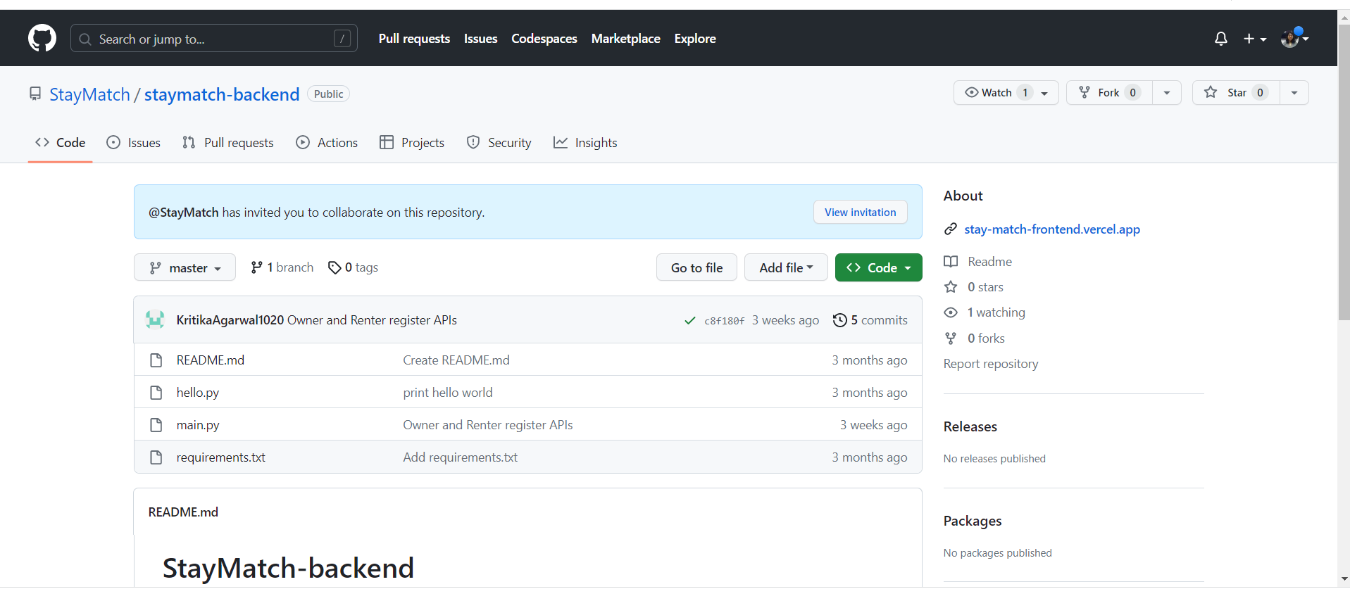
StayMatch Backend

Slide 3
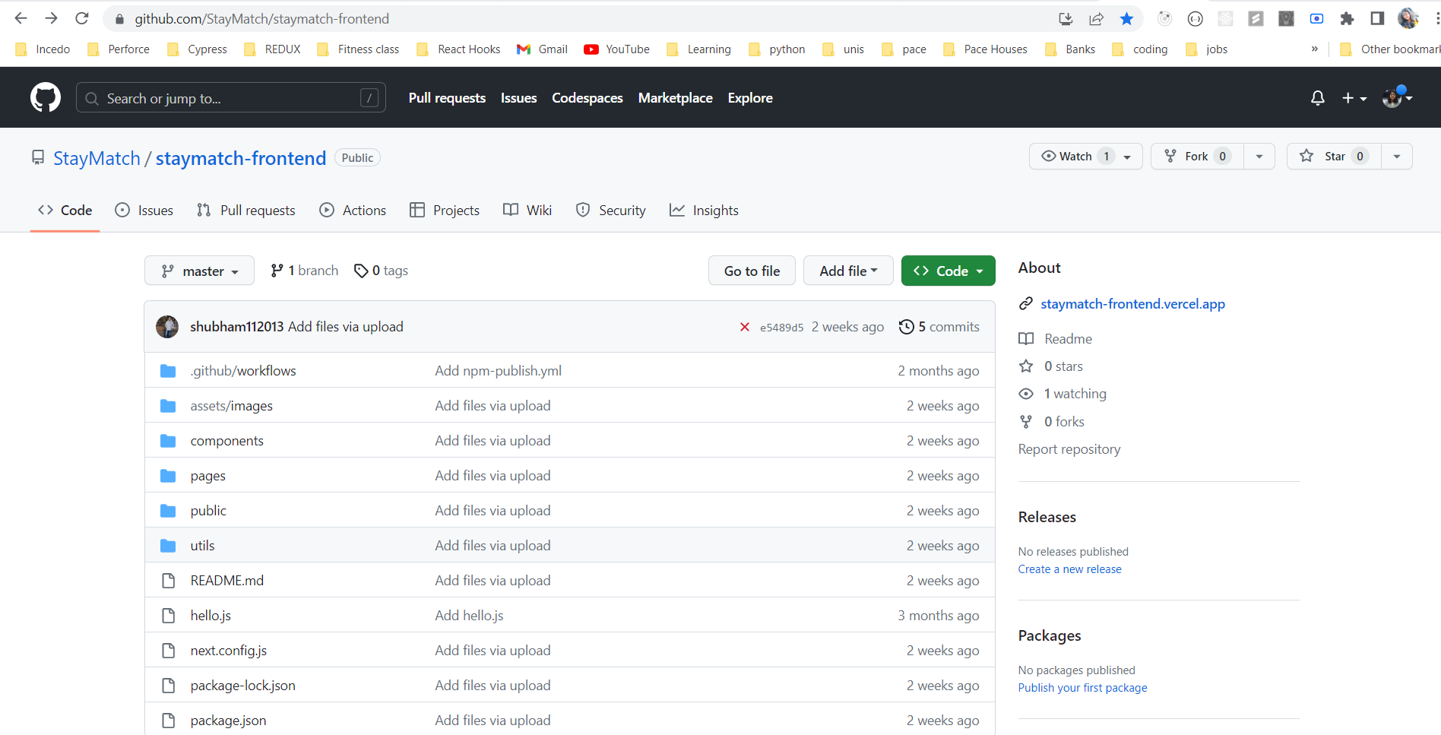
StayMatch FrontEnd

